Slide 1
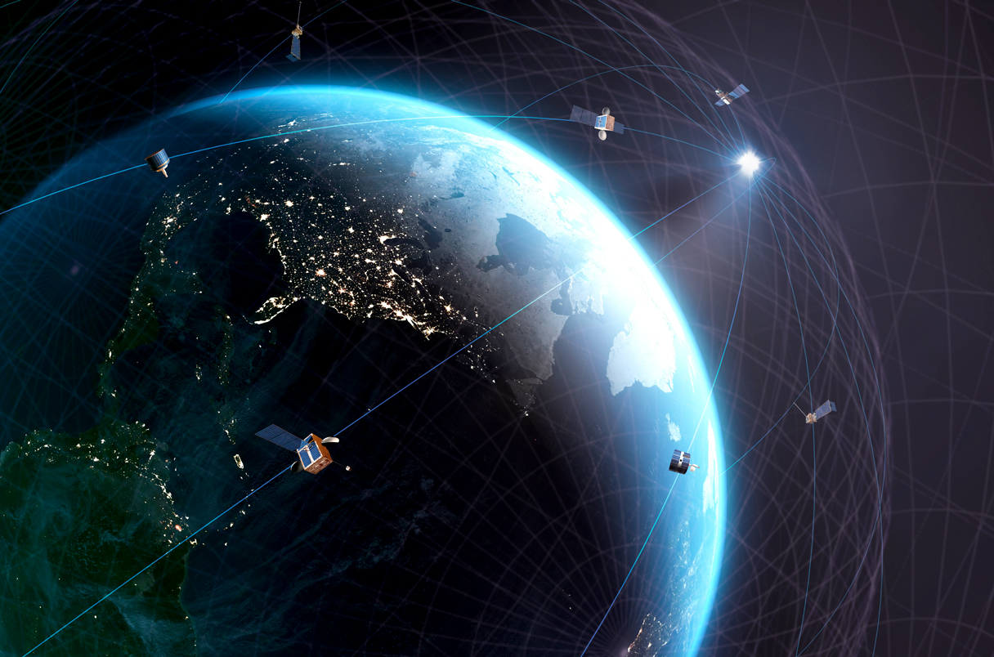
Estimation of a site where motion of a moving vehicle started using radar data
Coordinate transformation of measurements
21 September 2022
Team ANTI Pineapple Pizza

Slide 2

Table of contests
Problem statement
Procedure
Results

Slide 3

Problem Statement
Estimate the site of which the vehicles arrived to the destination point
Knowing the initial and final point and evaluating the dynamics is important for:
Movement control
Tracking rockets, cars, ships

Slide 4




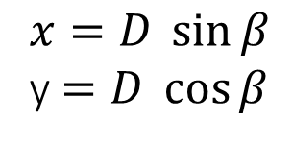
Coordinate transformation
From polar to cartesian coordinate system
y
$$β$$
$x=D \sin{β }$
y$=D \cos{β}$
x

Slide 5
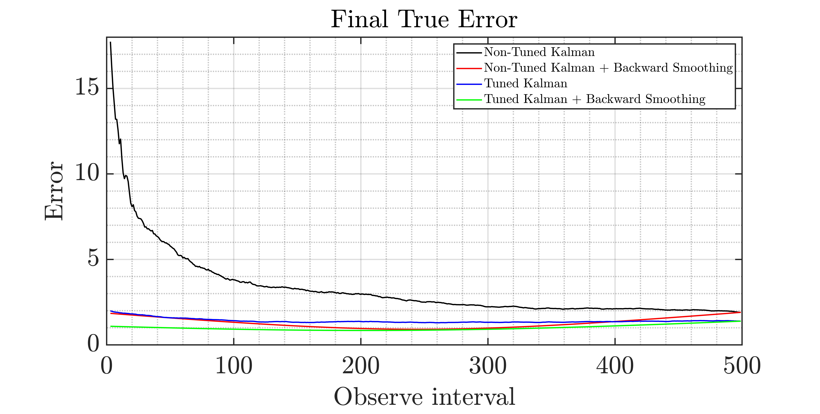
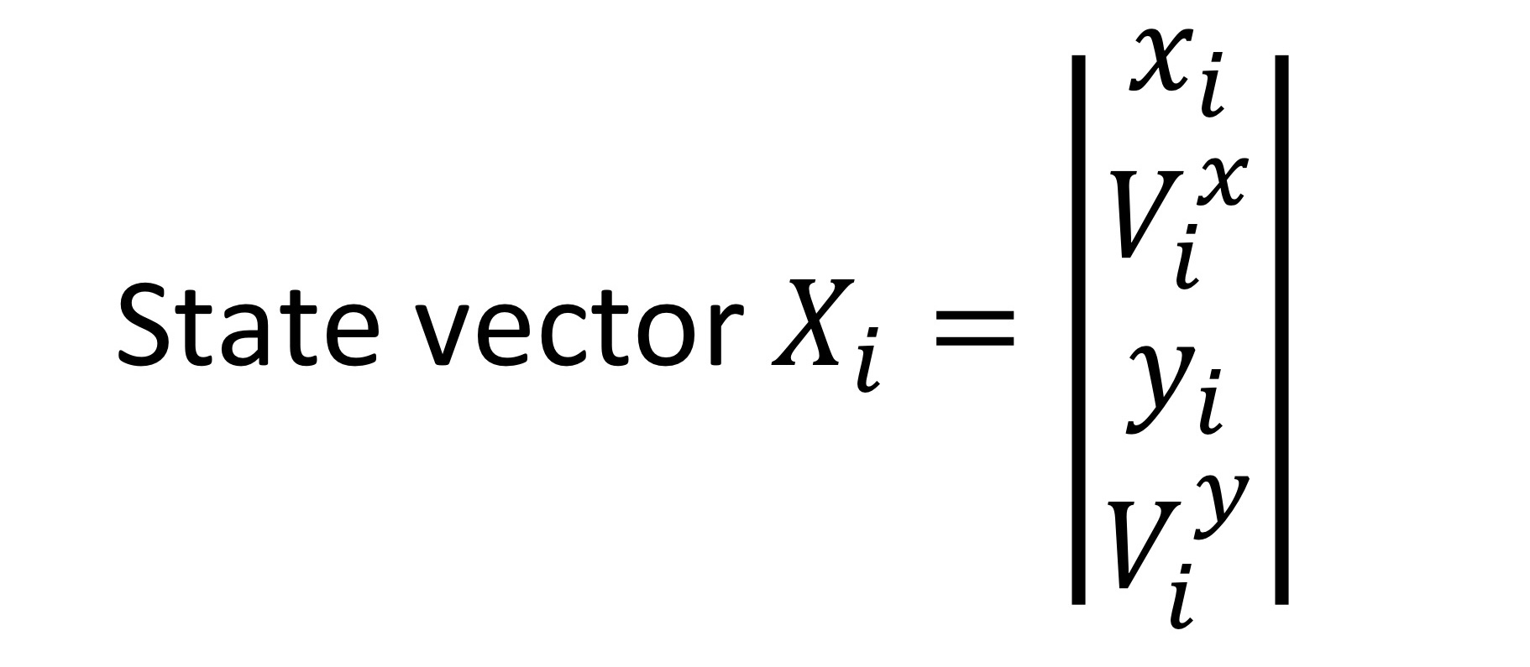


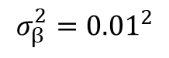
Choosing the method
$$σ_{β}^{2}={0.01}^{2}$$
$$σ_{D}^{2}={200}^{2}$$
$$σ_{a}^{2}={0.01}^{2}$$

Slide 6


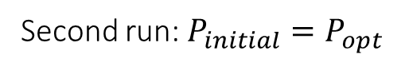
Optimization of Kalman Filter
For standard filter:
One run: $P_{initial}= P_{0,0}$
For tuned filter:
First run: $P_{initial}= P_{0,0} →P_{opt}$
Second run: $P_{initial}=P_{opt}$

Slide 7
Results
Y [m]
X [m]

Slide 8
Results
Y [m]
X [m]

Slide 9
Thank you for your attention
Irina and Luca

